Slide 1

Credit Card Financial Report

Slide 2
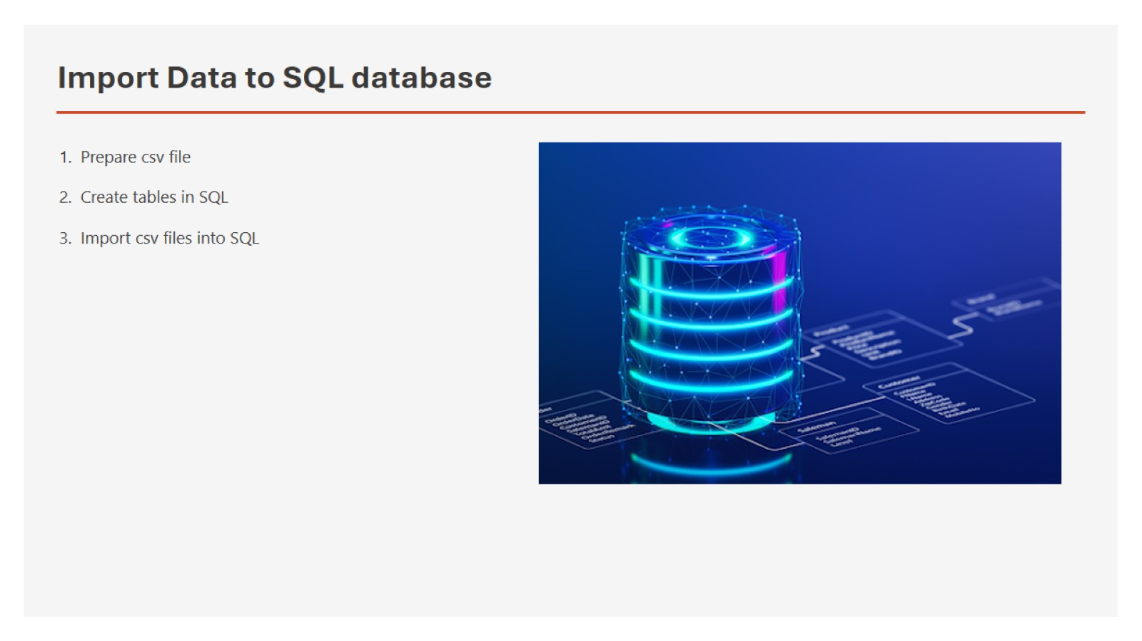
Import Data to SQL database

Slide 3
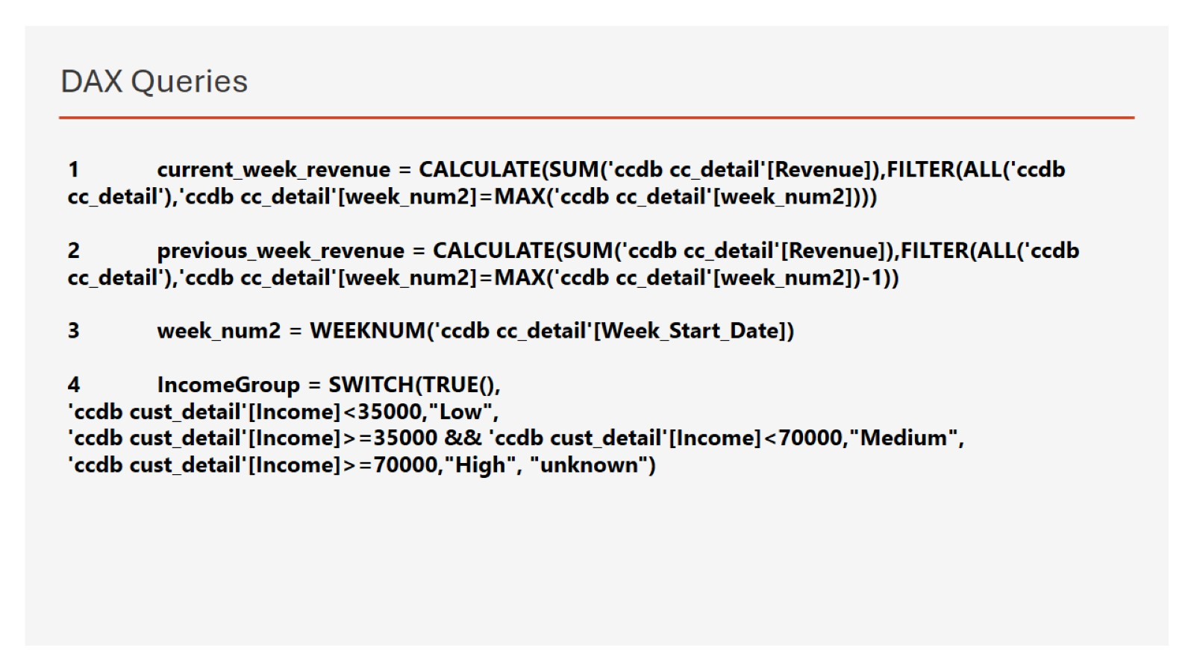
DAX Queries

Slide 4
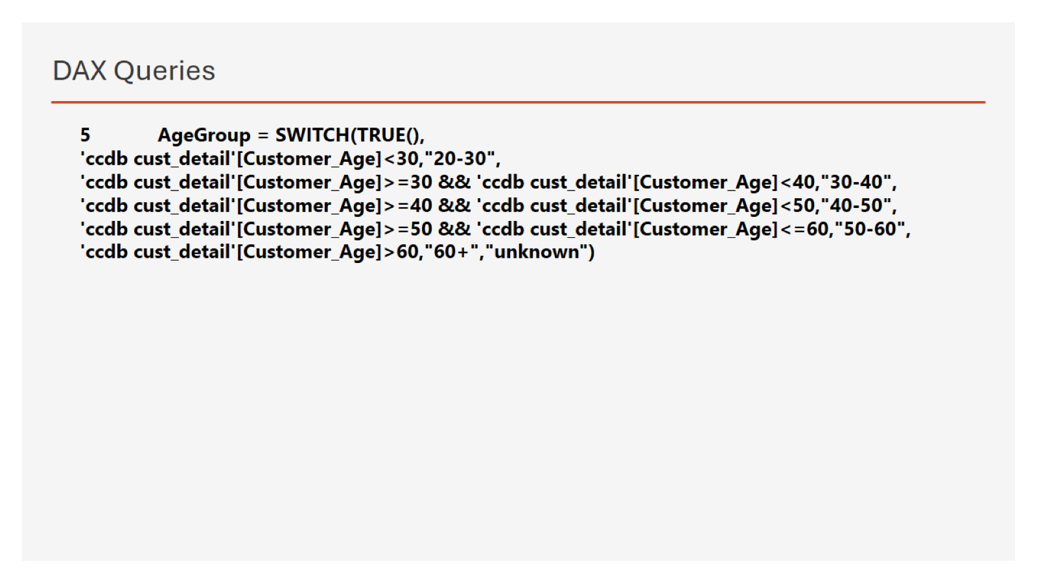
DAX Queries

Slide 5
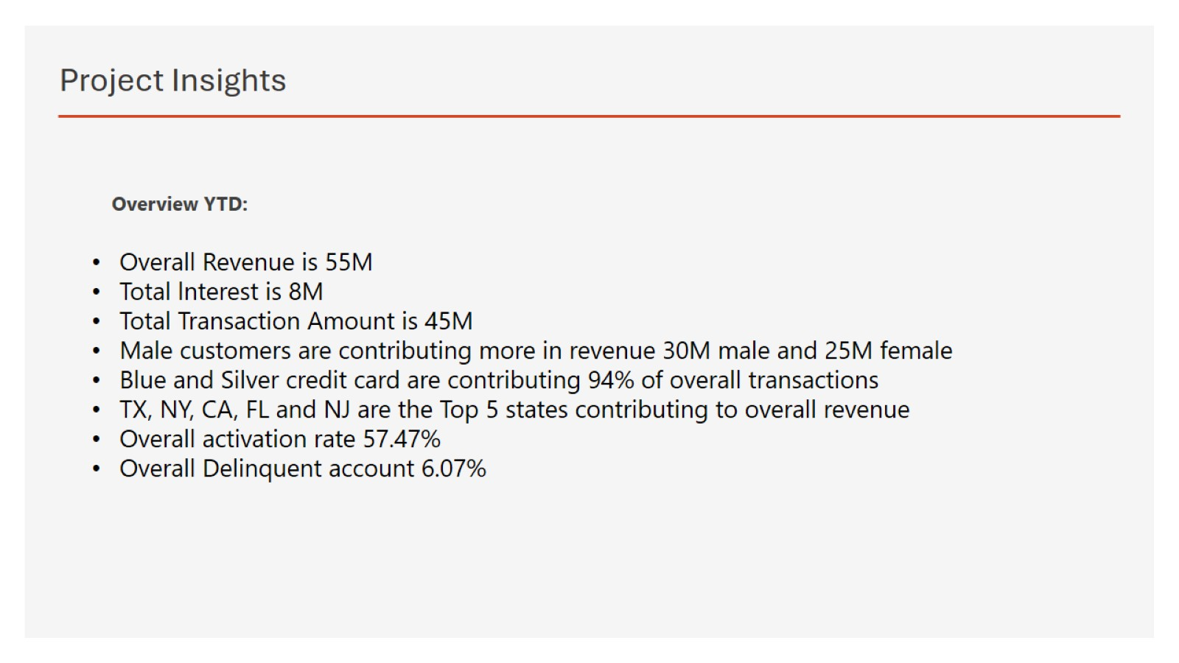
Project Insights

Slide 6
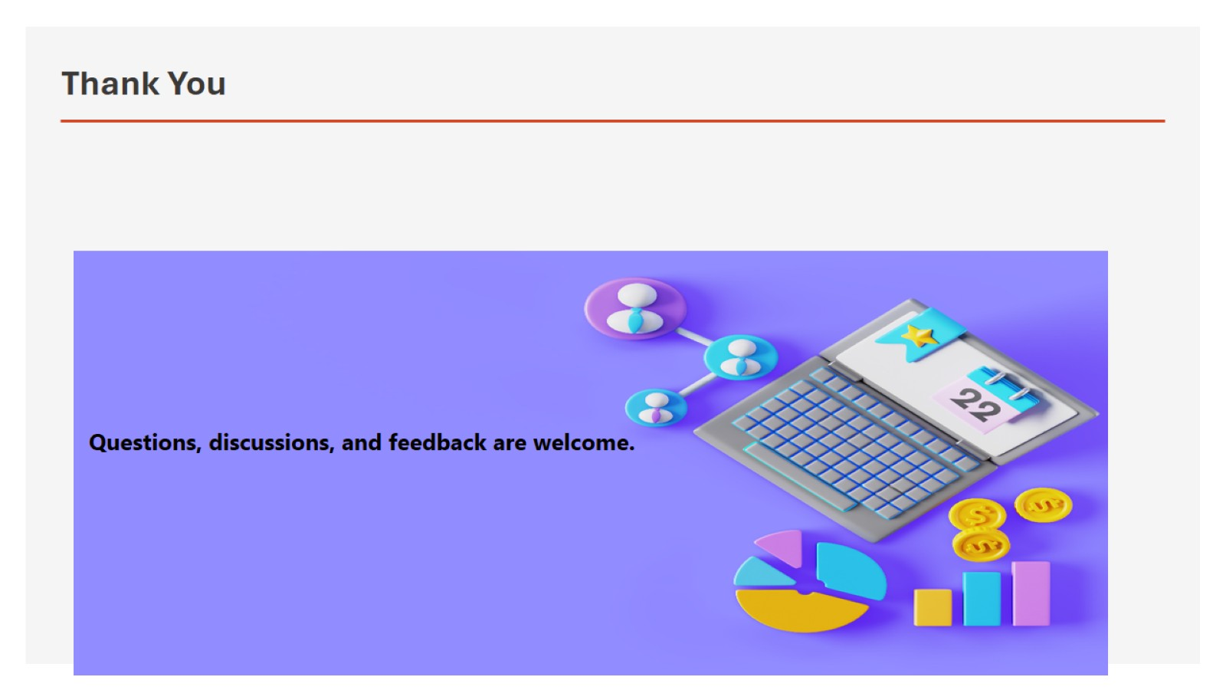
Thank You

